Slide 1
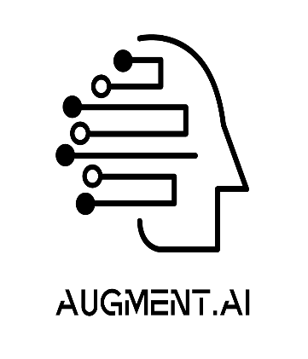

AI - VERSE 2025
TITLE : Develop an AI bot with a Voice assistant that listens to end-user questions/queries and replies back with a proper response(S2S) system. The challenge here would be that the end user can speak in any language and the bot should be able to respond in the same language. The AI bot should have a character and a back story.
TEAM NAME: Team Genesis
TEAM MEMBERS:
Aditya Ajith Kumar – 1BG22CS007
Dumpa Revanth Venkata Sai – 1BG22CS043
Hanoch Yedidya Karkada – 1BG22CS054
Harshitha Sanjana R – 1BG22CS057

Slide 2
.
IDEA TITLE
PROPOSED SOLUTION
Objective: Develop an AI voice assistant that:
Listens to user queries in any language.
Responds in the same language with a consistent character and backstory.
Character Example:
Name: Victor
Persona: Rude, sarcastic banker with 20 years of experience.
Backstory: Worked in a high-pressure financial firm, dislikes trivial questions, grumbles but eventually helps.
Core Feature: Speech-to-Speech (S2S) system with real-time language detection and response generation

Slide 3
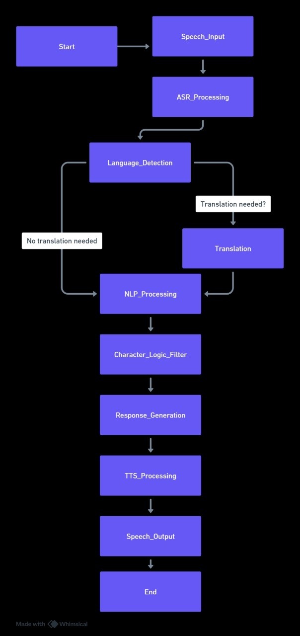
TECHNICAL APPROACH
This flowchart outlines how a speech-based AI system processes user input.
It starts by capturing spoken words, converting them to text, and detecting the language.
If needed, the system translates the text before understanding the meaning using NLP.
After filtering and generating a response, it converts the text back into speech and delivers the final output.

Slide 4
FEASIBILITY AND VIABILITY
TECH AVAILABILITY
Existing ASR, NLP, APIs and TTS tools support multilingual capabilities.
CHALLENGES
Real-time language switching and maintaining character consistency across languages.
Within the given timeframe, we made our best effort to implement the solution using multiple approaches.
VIABILITY
Scalability: Cloud-based APIs (e.g., Google Cloud, AWS) ensure global language support.
Cost: Initial development moderate; ongoing costs depend on API usage.

Slide 5
IMPACTS AND BENEFITS
IMPACT
Unique user experience with a memorable, engaging persona.
Breaks monotony of generic AI assistants.
Appeals to niche markets (e.g., banking customers who enjoy quirky interactions).
BENEFITS
User Engagement: Character-driven responses increase retention.
Flexibility: Multilingual support broadens audience reach.
Brand Identity: Victor’s personality along with various other personalities like Friendly Chef, Sci-Fi Robot can align with a company’s edgy or bold image.
Practicality: Provides accurate answers despite the attitude.

Slide 6
GITHUB REPO LINK
https://github.com/AdityaAjithKumar/Genesis_Personalised_AI

